Slide 1
Problem Statement:
A Drone is being used to deliver medicines in a hilly region with flight distance of 10 kms to destination. Unfortunately, the Drone is prone to attack by birds of prey such as Eagle, Crow etc. at around 5 kms from origin.
Design a system for Drone to deter the bird attacks and to safely traverse the remaining distance to destination to deliver the medicines. Cost of the system should not exceed Rs. 50000/- and weight of the proposed deterrence system should not exceed 1.5 kg.
Note: The hilly area is prone to drizzles and wind gust.
© 2025 Collins Aerospace. | Collins Aerospace Proprietary. | This document does not include any export controlled technical data.

Slide 2
SkyGuard Smart Bird Deterrence System for Medical Delivery Drones AeroHack 2025 Submission name:-sania firdose (1si22ec086)department of ece institute:-siddaganga institute of technology,tumkuru

Slide 3
Project Overview
SkyGuard is a smart, lightweight, and adaptive bird deterrence system that:
Detects and classifies bird threats using thermal vision and AI.
Adapts response level based on threat severity.
Ensures continued delivery even in adverse weather.

Slide 4
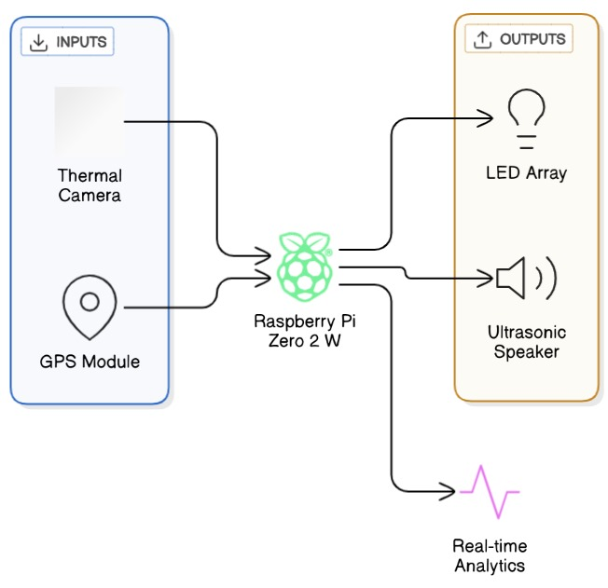

System Architecture Diagram

Slide 5
Innovation Highlights
Thermal AI Detection & Threat Classification
Not just "bird or not" — but how far, what speed, what behavior
Adaptive Response System (ARS)
Varies deterrent strategy: Sound, Light, Motion, Zigzag Escape
Weather Adaptation
Fog/drizzle mode activates alternative deterrence strategy
Geofenced Zone Activation
Activates only in attack-prone zone to save power

Slide 6
Component List
Component | Function | Price | Weight
Raspberry Pi Zero 2 W | Microcontroller | ₹2,000 | 11g
MLX90640 Thermal Camera | Threat detection | ₹6,500 | 15g
NEO-6M GPS Module | Geofencing | ₹500 | 25g
Strobe LED Array | Visual deterrent | ₹1,500 | 150g
Ultrasonic + Speaker | Sound deterrent | ₹2,000 | 300g
3S LiPo Battery | Power | ₹2,500 | 200g
Waterproof Housing | Protection | ₹1,500 | 250g
Misc (PCB, mounts, wiring) | Integration | ₹2,000 | 200g
Total |  | ₹18,500 | 1.15 kg

Slide 7
How It Works
Thermal Vision Module continuously scans for heat signatures.
AI model classifies approaching objects: bird vs non-bird + threat level.
If bird is detected:
Mild Threat → Short ultrasonic bursts.
Moderate Threat → Flashing LEDs + predator call.
Severe Threat → Drone performs zigzag maneuver + full deterrence.
Zone-aware logic activates system only in risky areas.
Weather sensor enables fog mode where strobe is disabled, and audio/motion dominate.

Slide 8
Bird Behaviour Classification
1. Just Flying (Harmless)
Flight Path: Straight line motion.
Speed: Constant and moderate.
Direction Changes: Very low; mostly linear movement.
Approach Angle: Parallel to or moving away from the drone.
Proximity: Remains distant from the drone.
Heat Signature: Small and stable infrared signature.
Presence Duration: Very brief (1–2 seconds).
Vertical Movement: Maintains level flight.
Use Case: No action required. This is typical of birds flying through the area without interest in the drone.

Slide 9
Bird Behaviour Classification
2. Circling (Suspicious)
Flight Path: Circular or elliptical pattern around the drone.
Speed: Slower and fluctuating.
Direction Changes: High; frequently alters direction.
Approach Angle: Circles around the drone, not directly approaching.
Proximity: Maintains the same distance from the drone.
Heat Signature: Slight variation, indicating hovering motion.
Presence Duration: Longer, ranging from 5–10 seconds.
Vertical Movement: Slight vertical motion (up/down drift).
Use Case: Potential threat. The drone should switch to alert mode and activate soft deterrents.

Slide 10
Bird Behaviour Classification
3. Diving/Attacking (Dangerous)
Flight Path: Steep diagonal or curved trajectory aimed at the drone.
Speed: Rapidly increasing; fast approach.
Direction Changes: Sudden directional shift directly toward the drone.
Approach Angle: Direct and aggressive toward the drone center.
Proximity: Quickly decreases—bird rapidly closes the gap.
Heat Signature: Rapidly enlarging due to decreasing distance.
Presence Duration: Short, but increasing rapidly.
Vertical Movement: Sharp descent; rapid drop toward drone.
Use Case: Immediate danger. Drone must activate evasive maneuvers and strong deterrents.

Slide 11
Actuator Response based on threat classification
Mild Threat (bird flying past): Ultrasonic pulses activated (brief and low intensity) No LED or speaker activated to save power
Moderate Threat (bird circling/hovering): High-Intensity RGB LEDs start flashing Predator bird sound played via speaker Ultrasonic pulse frequency increased
Severe Threat (bird diving or approaching rapidly): All deterrents activated simultaneously Ultrasonic sound at full power LEDs flash in aggressive burst pattern Predator call sounds at max volume Failsafe: sends alert and performs evasive action

Slide 12
SkyGuard ensures uninterrupted medical drone delivery in bird-prone zones.
Combines AI, thermal sensing, and adaptive deterrence for real-time threat management.
and zone-aware, saving energy and maximizing effectiveness.
THANK YOU!
Keeping the skies safe for life-saving missions.
Presented by: Sania Firdose (1SI22EC086) Department of ECE Siddaganga Institute of Technology, Tumakuru

